Slide 1
A PROJECT REPORT ON “Sales Management System” SUBJECT Programming in Problem Solving Using C++ SUBMITTED BY Mr. Gite Sai Kiran PRN : 2124UCEM1029 Under the guidance of Miss. Ishwari Tirse

Slide 2

Department of Computer Science and Engineering
Sanjivani Rural Education Society’s
SANJIVANI UNIVERSITY
KOPARGAON – 423603, DIST : AHMEDNAGAR
2024-2025

Slide 3
INDEX
SR.NO. | CONTENT | PAGE NO.
1. | INTRODUCTION | 4
2. | CODE | 6
3. | OUTPUT | 10
4. | CONCLUSION | 13

Slide 4
INTRODUCTION
The sales management system can be the most promising C++ project as it is ideal for learning many new things. It comprises different classes and sub-classes that further involve different features and functions related to items entry, items recording, billing etc.The main aim of this project is to design a system through which we can manage customer information, delivery details, stock details etc.
There are mainly three such objectives:
Contribution of profits
Continuous growth
Sales volume

Slide 5
Benefits/USE of a Sales Management System :
Improved Sales Performance: By providing a clear picture of the sales pipeline and enabling data-driven decisions.
Enhanced Customer Relationships: By facilitating effective communication and personalized interactions.
Increased Efficiency: By automating tasks and streamlining processes.
Better Decision Making: By providing realtimeinsights and analytics.

Slide 6
Code
#include <iostream>
#include <vector>
#include <string>
#include <iomanip>
using namespace std;
struct Sale {
string itemName;
double itemPrice;
int quantitySold;
};
void addSale(std::vector<Sale>& sales) {
Sale sale;
cout << "Enter item name: ";
cin >> sale.itemName;
cout << "Enter item price: ";
cin >> sale.itemPrice;
cout << "Enter quantity sold: ";
cin>>sale.quantitySold;
sales.push_back(sale);
}
void displaySales(const vector<Sale>& sales) {
cout <<fixed << setprecision(2);
cout << "Sales Records:\n";
for (const auto& sale : sales) {

Slide 7
double totalSale =sale.itemPrice* sale.quantitySold;
cout << "Item: " << sale.itemName
<< ", Price: $" << sale.itemPrice
<< ", Quantity Sold: " << sale.quantitySold
<< ", Total Sale: $" << totalSale << "\n";
}
}
double calculateTotalSales(const vector<Sale>& sales) {
double total = 0.0;
for (const auto& sale : sales) {
total += sale.itemPrice * sale.quantitySold;
}
return total;
}
void searchSale(const vector<Sale>& sales, const string& itemName) {
bool found = false;
for (const auto& sale : sales) {
if (sale.itemName == itemName) {
double totalSale = sale.itemPrice * sale.quantitySold;
cout << "Found Sale - Item: " << sale.itemName
<< ", Price: $" << sale.itemPrice
<< ", Quantity Sold: " << sale.quantitySold
<< ", Total Sale: $" << totalSale << "\n";
found = true;
break;
}
}
if (!found) {
cout << "No sale found for item: " << itemName << "\n";

Slide 8
}
}
int main() {
vector<Sale> sales;
char choice;
do {
cout << "1. Add sale record\n";
cout << "2. Display all sales records\n";
cout << "3. Calculate total sales\n";
cout << "4. Search for a specific sale\n";
cout << "5. Exit\n";
cout << "Enter your choice: ";
cin >> choice;
switch (choice) {
case '1':
addSale(sales);
break;
case '2':
displaySales(sales);
break;
case '3': {
double total = calculateTotalSales(sales);
cout << "Total sales: $" << total << "\n";
break;
}
case '4': {
string itemName;
cout << "Enter item name to search: ";

Slide 9
cin >> itemName;
searchSale(sales, itemName);
break;
}
case '5':
cout << "Exiting...\n";
break;
default:
cout << "Invalid choice. Please try again.\n";
}
} while (choice != '5');
return 0;
}

Slide 10
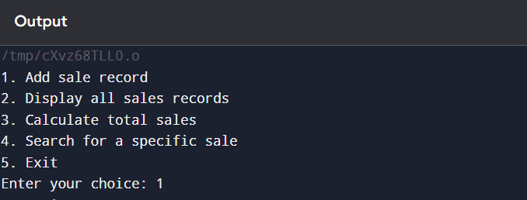
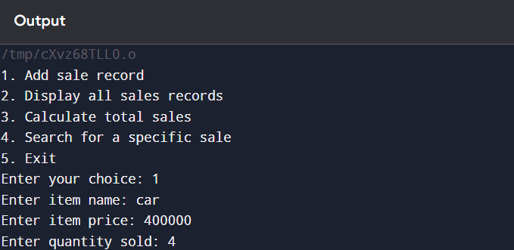
Output
1.Launching the program :
2. Adding sales record :

Slide 11
3.Display all sales records :
4.Calculating Total Sales :

Slide 12
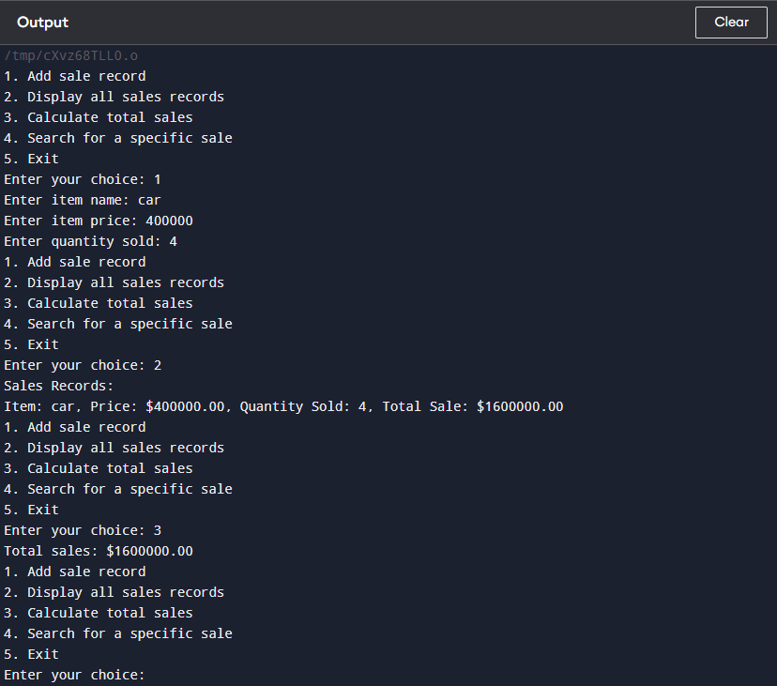
output

Slide 13
CONCLUSION
In conclusion, a sales management system is an essential tool for organizations aiming to enhance their sales processes and overall performance. By integrating various components such as contact management, sales forecasting, performance management, and sales automation, these systems provide a comprehensive approach to managing sales efforts.

Slide 14
Thank you

